Slide 1

AKS Office Hours
Kendall Roden
Cloud Native Technical Specialist
Kendal Roden
Cloud Native Technical Specialist
Dave Strebel
Cloud Native Technical Specialist

Slide 2




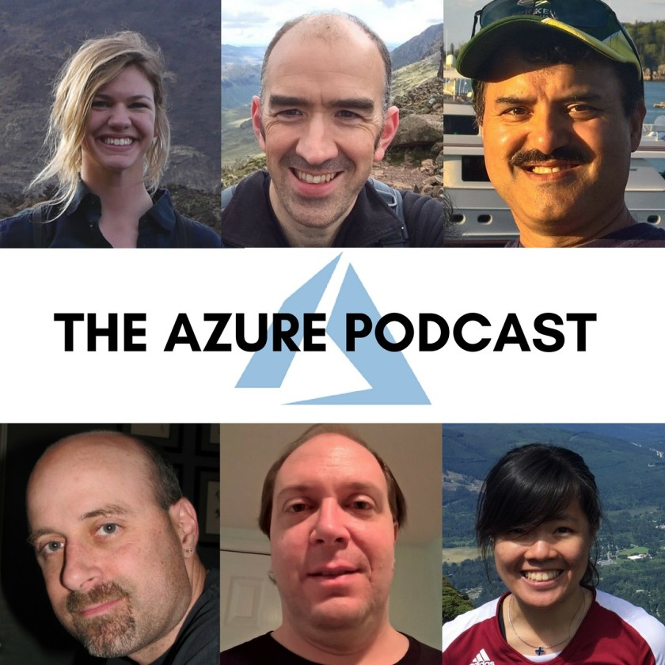


Who are we?
@kendallroden​
@dave_strebel​

Slide 3
Why AKS Office Hours?
Provide AKS customers with updates pertaining to AKS and the Cloud Native Ecosystem
Host a short talk and/or demo on Cloud Native technologies related to Kubernetes and AKS
Collect feedback from customers on issues, blockers, use cases, and questions related to AKS

Slide 4
What to expect
Call agenda
5-10 minutes: Welcome, followed by AKS and ecosystem updates
20-30 minutes: Service Mesh Discussion with Dave Strebel– Cloud Native Technical Specialist
20-30 minutes: “Ask us anything” and customer feedback discussion
Keep in mind
We want two-way interaction, but please stay on mute when you are not speaking
This call and how it is conducted will evolve based on feedback and growth
Office hours are hosted primarily by the GBB team, with the support of the PG
Recordings and content will be available post-call, barring any technical difficulties
Contact us with thoughts, ideas or questions (aksofficehours@microsoft.com)

Slide 5

AKS Updates

Slide 6
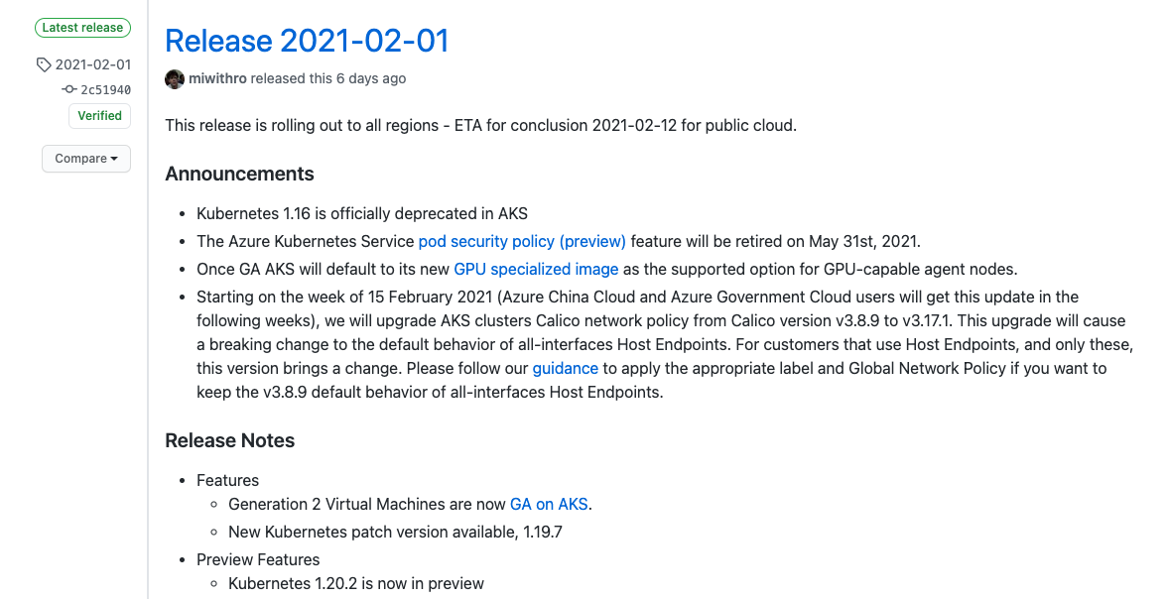
AKS Release Notes
Kubernetes v1.20 overview
Quick upstream look ahead: A whole bunch of v1beta1 API versions are going away when 1.22 gets released, including CRDs and webhooks. Time to refactor your YAML files again!
Notes:
Previous ones:
Pod security policy (preview) feature retirement = May 31st, 2021
Once GA, AKS will default to its new GPU specialized image
1.16.x clusters cannot be created anymore
New:
Simplified access for integration with AAD including support for Conditional Access
No admin accounts if desired
Release Notes: https://github.com/Azure/AKS/releases/tag/2021-01-25
Azure AD Conditional Access: https://docs.microsoft.com/azure/aks/managed-aad#use-conditional-access-with-azure-ad-and-aks
Auto-upgrade channel: https://docs.microsoft.com/en-us/azure/aks/upgrade-cluster#set-auto-upgrade-channel-preview

Slide 7
Ecosystem Updates

Slide 8
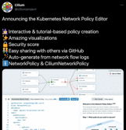


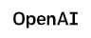

Open Source and Ecosystem call outs
KubeEdge The Most Insane Open-Source Project of 2020
Lightweight, compliant k8s distro for running cn workloads in IoT devices at the edge
CNCF incubating project
CNCF Predictions for 2021 & Beyond!
Cloud-native IDEs, Kubernetes on the Edge, Rust in Cloud Native & more…
Scaling Kubernetes to 7,500 Nodes
OpenAI talks scaling for large models like GPT-3
KubeLinter
Static analysis for Kubernetes by Stackrox
Checks Yaml and Helm for best practices
CNCF Predictions for 2021 & Beyond!
Cloud-native IDEs, Kubernetes on the Edge, Rust in Cloud Native & more…
Kubernetes Network Policy Editor by Cilium
Editor.cilium.io
The Cloud Native Landscape: The Application Definition and Development Layer – The New Stack
Notes:
Cloud Native IDEs- think GitHub Codespaces (beta)
K8s on the edge
Cloud Native + Web Assembly (Wasm)
Rise of FinOps- KubeCost – Linux foundation launch the finops foundation to help innovation for managing cloud cost
More rust
Gitops
Service catalogs- cn developer dashboards
Cross cloud
eBPF extending the behavior of the linux kernel – projects like falco and cilium are eBPF based (sandboxed extension mechanism for the kernel)

Slide 9
Service Mesh Overview

Slide 10
Agenda
What is a Service Mesh?
When do I need a Service Mesh?
What is Open Service Mesh (OSM)?
Principles
Features
Linkerd Demo

Slide 11
What is a Service Mesh
A service mesh is a tool for adding observability, security, and reliability features to applications by inserting these features at the platform layer rather than the application layer
The rise of the service mesh is tied to the rise of “Cloud Native” (i.e. Microservices)
The term "service mesh" was coined by William Morgan (Buoyant, Linkerd)
2017 was the year that service meshes became popular
Notes:
So as companies began to refactor and/or re-platform their applications following a microservice model, the complexity of controlling communications between these applications with traditional methods becomes more and more complex to manage.
And a lot the complexity comes with a traditional operational approach that may not scale with these new systems that are providing microservices hosting platforms such as Kubernetes, so we need a new approach and that gave birth to what’s now known as a service mesh

Slide 12
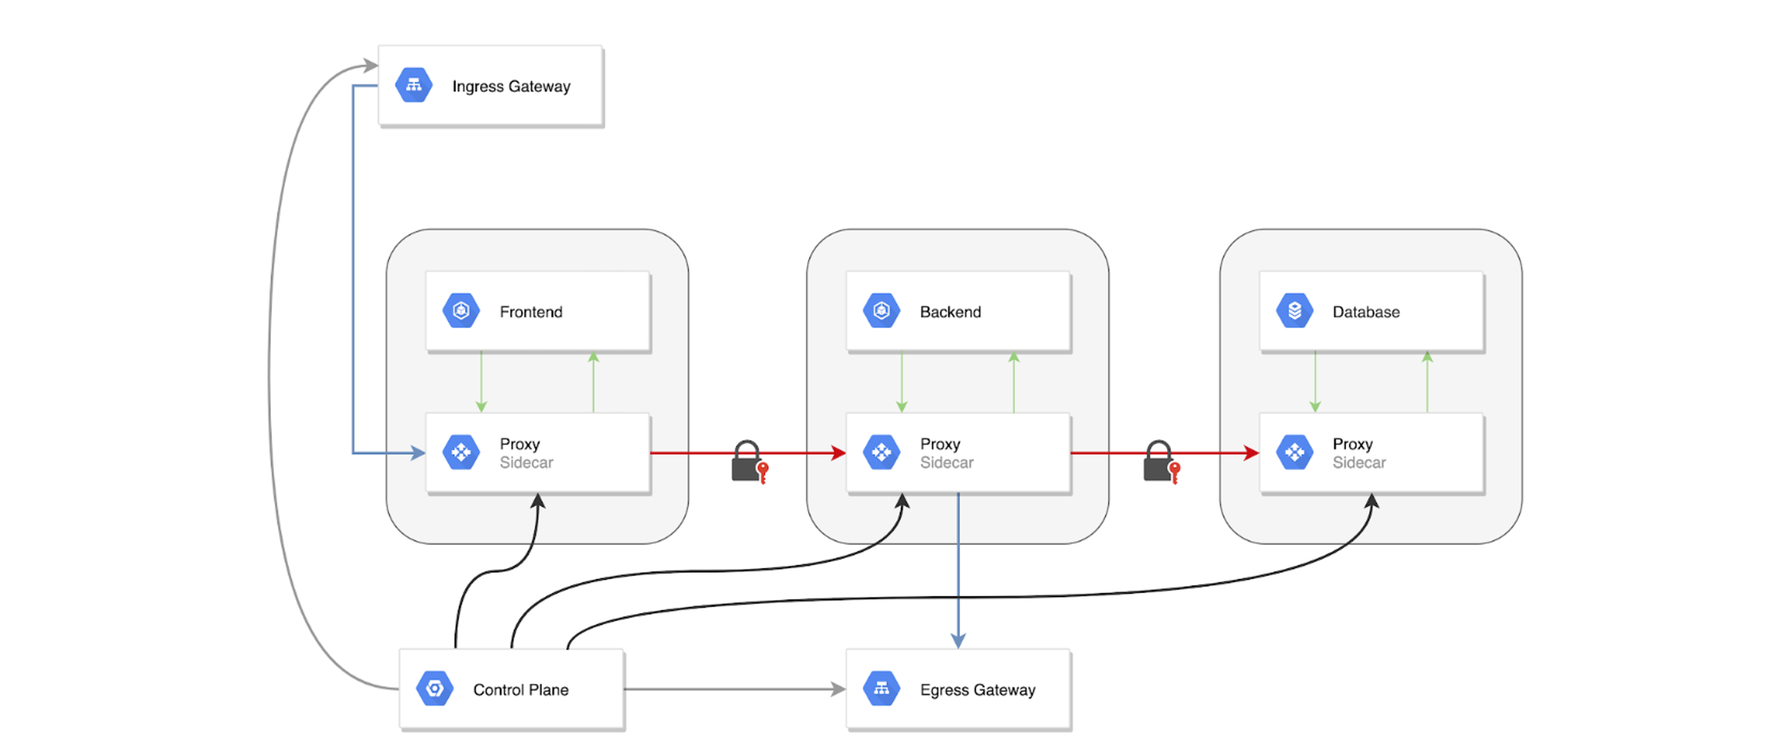
Service Mesh Traffic Overview

Slide 13
When do I need a service mesh?
Your microservices are all written in one language
Org dedicates engineers to building specific tooling and instrumentation
Have a partially or totally monolithic architecture
You release all-at-once
Use protocols not served by current service meshes
Notes:
The urgency of considering a service mesh depends on your organization’s challenges and goals, but can also be considered by your current process or state of operations.
Here are some states that may reduce or eliminate your urgency to use a service mesh:

Slide 14
When do I need a service mesh? (cont.)
You have microservices written in multiple different langages
Your teams are re-solving utility code (ie cert rotation)
You have stringent security needs
Your teams spends more time understanding than fixing
Need observability across boundaries
Notes:
The urgency of considering a service mesh depends on your organization’s challenges and goals, but can also be considered by your current process or state of operations.
Here are some states that may reduce or eliminate your urgency to use a service mesh:

Slide 15







Service Mesh Landscape
Notes:
So as you can imagine this is a very active space, filling up with many vendors
This is just a slice of service meshes available and there’s probably another 5-10 not listed here, all trying to solve the complexity of securing service-to-service communications

Slide 16
Service Mesh Landscape
The original service mesh
Purpose built
Lightweight
User Experience
Kubernetes Only
Sort-of multi-cluster
Developed Google+IBM
Loosely based on Google Tech
Feature rich
Supports multi-cluster and VMs
Complex (getting better)
Envoy Proxy
Feature rich
Initially service discovery and distributed key/value store
Rich support for hybrid architectures
Lacks Observability features (getting better)
Can be complex for initial setup/architecture
Managed Service
Notes:
So as you can imagine this is a very active space, filling up with many vendors
This is just a slice of service meshes available and there’s probably another 5-10 not listed here, all trying to solve the complexity of securing service-to-service communications

Slide 17
Open Service Mesh
Work in progress v0.7
Utilizes Envoy proxy
Uses Service Mesh Interface (SMI)
Secures end-to-end service to service communication by enabling mTLS
Defines and executes fine-grained access control policies for services
Observability & insights into app metrics for debugging and monitoring services
Integrates with external cert management services/solutions with pluggable interface
Easily and transparently configure traffic shifting for deployments
Notes:
If you think about the whole 80/20 rule, we again focused on the 80% of major needs and functionality to be made easy to do.

Slide 18


Demo Time!
Notes:
Cut video feed for demo environment

